Slide 1
Kubernetes made ‘simple’ with Azure Container Apps
Will Velida | Lead Software Engineer
@willvelida
August 2023

Slide 2
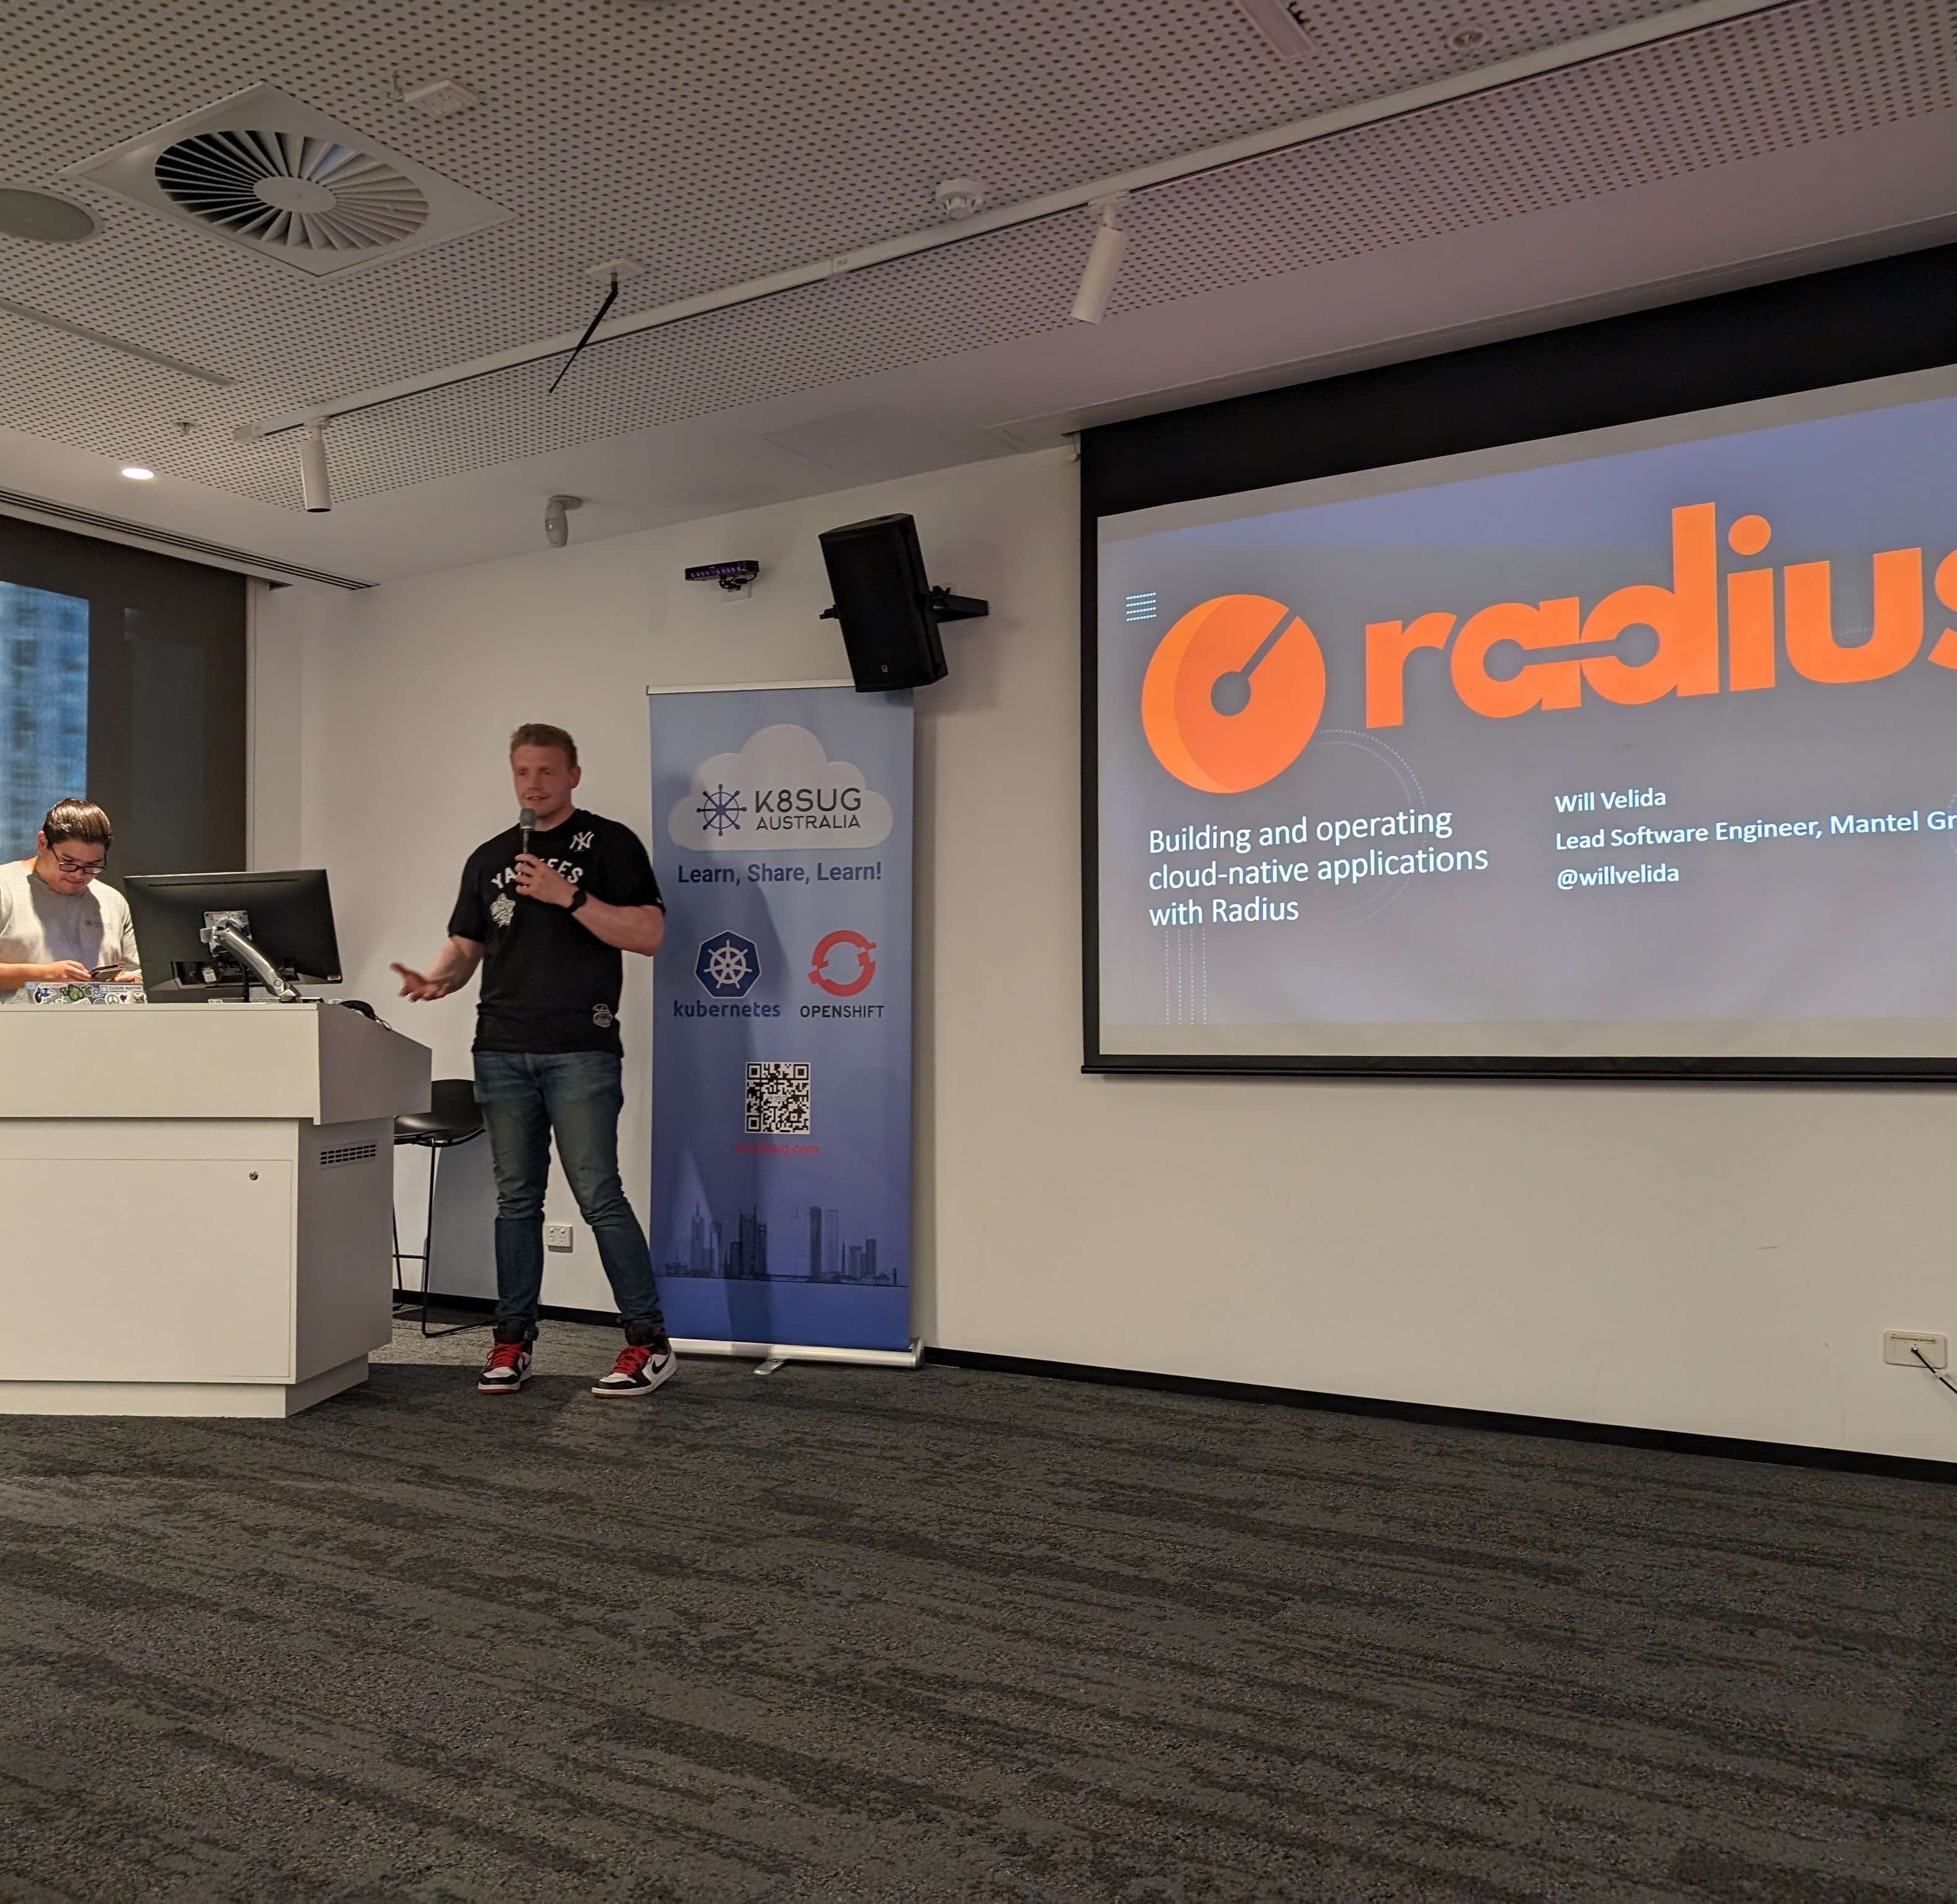
whoami?
Lead Software Engineer at Azenix by Mantel Group.
Former MSFTer and Microsoft MVP based in Auckland – Moved to Melbourne last year
.NET and Azure developer with experience in banking, agriculture, and health industries.
Former average rugby player.

Slide 3
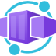
What are Azure Container Apps?

Slide 4
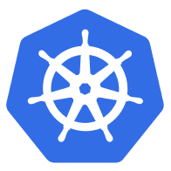



Azure Container Apps
Serverless containers for microservices
Build modern apps on open source
Focus on apps, not infrastructure
Scale dynamically based on events
Builds on Kubernetes, providing a fully managed and optimized environment
Kubernetes
KEDA
DAPR
Envoy
Notes:
Let’s start with a high level overview of Azure Container Apps.
Kubernetes is hard! We’re constantly seeing customers citing Kubernetes complexity as a blocker from adopting containers and microservices application patterns.
Azure Container Apps is built on a foundation of powerful open-source technology to deliver the same microservices benefits as Kubernetes as a fully managed and serverless app hosting option. Behind the scenes, every container app runs on Azure Kubernetes Service, with Kubernetes Event Driven Autoscaling (KEDA), Distributed Application Runtime (Dapr), and Envoy deeply integrated in the hosting service. However, developers and operators are not exposed to this underlying Kubernetes infrastructure. The open-source centric approach enables a path for teams to build microservices without having to overcome the concept and operational overhead of working with Kubernetes directly and enables continued app portability by leveraging open standards and APIs

Slide 5

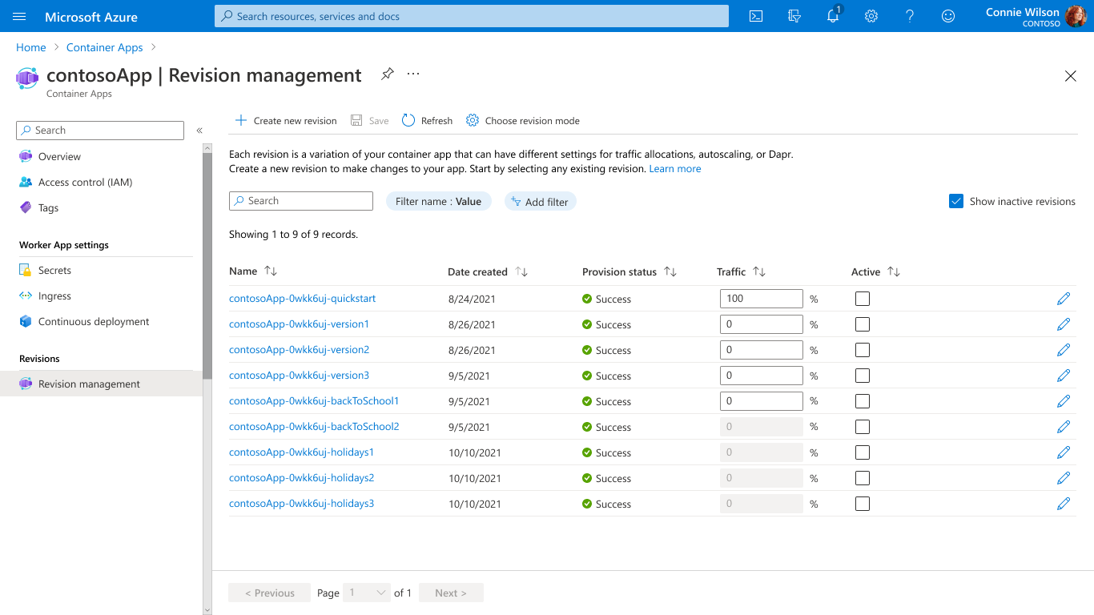
Build modern apps on open-source
Focus on apps, not infrastructure
Scale dynamically based on events
Build modern apps on open-source
→
App portability powered by open standards and APIs
App patterns and best practices encapsulated by products like Dapr
Service capabilities influenced by OSS contributions
→
→
Notes:
Container Apps is built on great open-source technology. It runs on top of Azure Kubernetes Service, KEDA, Dapr, and Envoy.
Since Container Apps is built-on top of AKS, KEDA, Envoy and Dapr, it allows you to take advantage of the capabilities of those platforms, such as built-in service discovery for microservices, fully managed HTTP and HTTP/2 ingress endpoints, etc. since they’re built in. This also gives us the advantage of being able to perform application lifecycle tasks such as upgrades, traffic shifting and versioning in a much simpler way than we would if we were managing the orchestrator infrastructure ourselves.

Slide 6
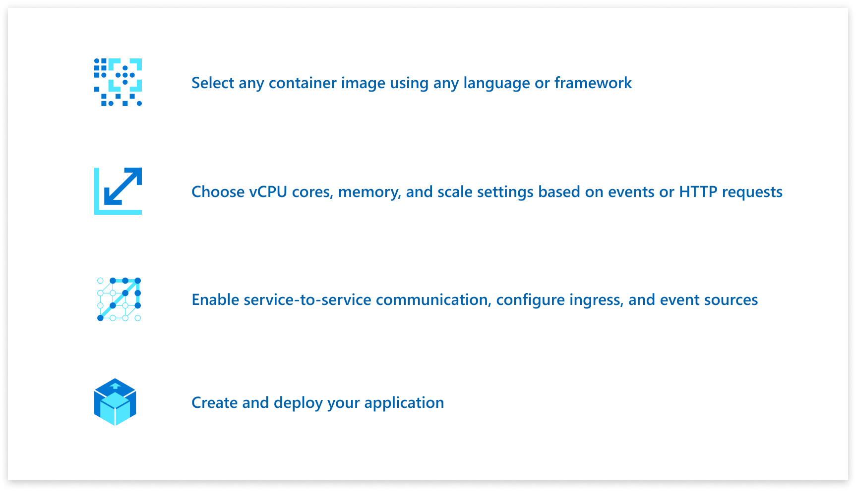
Build modern apps on open source
Focus on apps, not infrastructure
Scale dynamically based on events
Focus on apps, not infrastructure
→
Apps with any development stack, any Linux container image
No required programming model
High productivity development experience
→
→
Notes:
Because you’re not burdened by managing a container orchestrator, this gives you more time to focus on building your applications. With Container Apps, you can build microservices, APIs, event processing workers, and background jobs using containers and any programming language or framework and easy code-to-cloud pipeline using GitHub Actions.
Those of you who are coming from a Functions background, Container Apps provides us with more flexibility, since there’s no enforcement of a programming model and there are no limitations around languages. However, for those of you looking to deploy Windows Containers to Container Apps, that’s no possible (When or If it will be available, I can’t say).
Through the built-in integration with Distributed Application Runtime (Dapr), you can simplify common tasks like event processing, pub/sub, service invocation, and more.

Slide 7
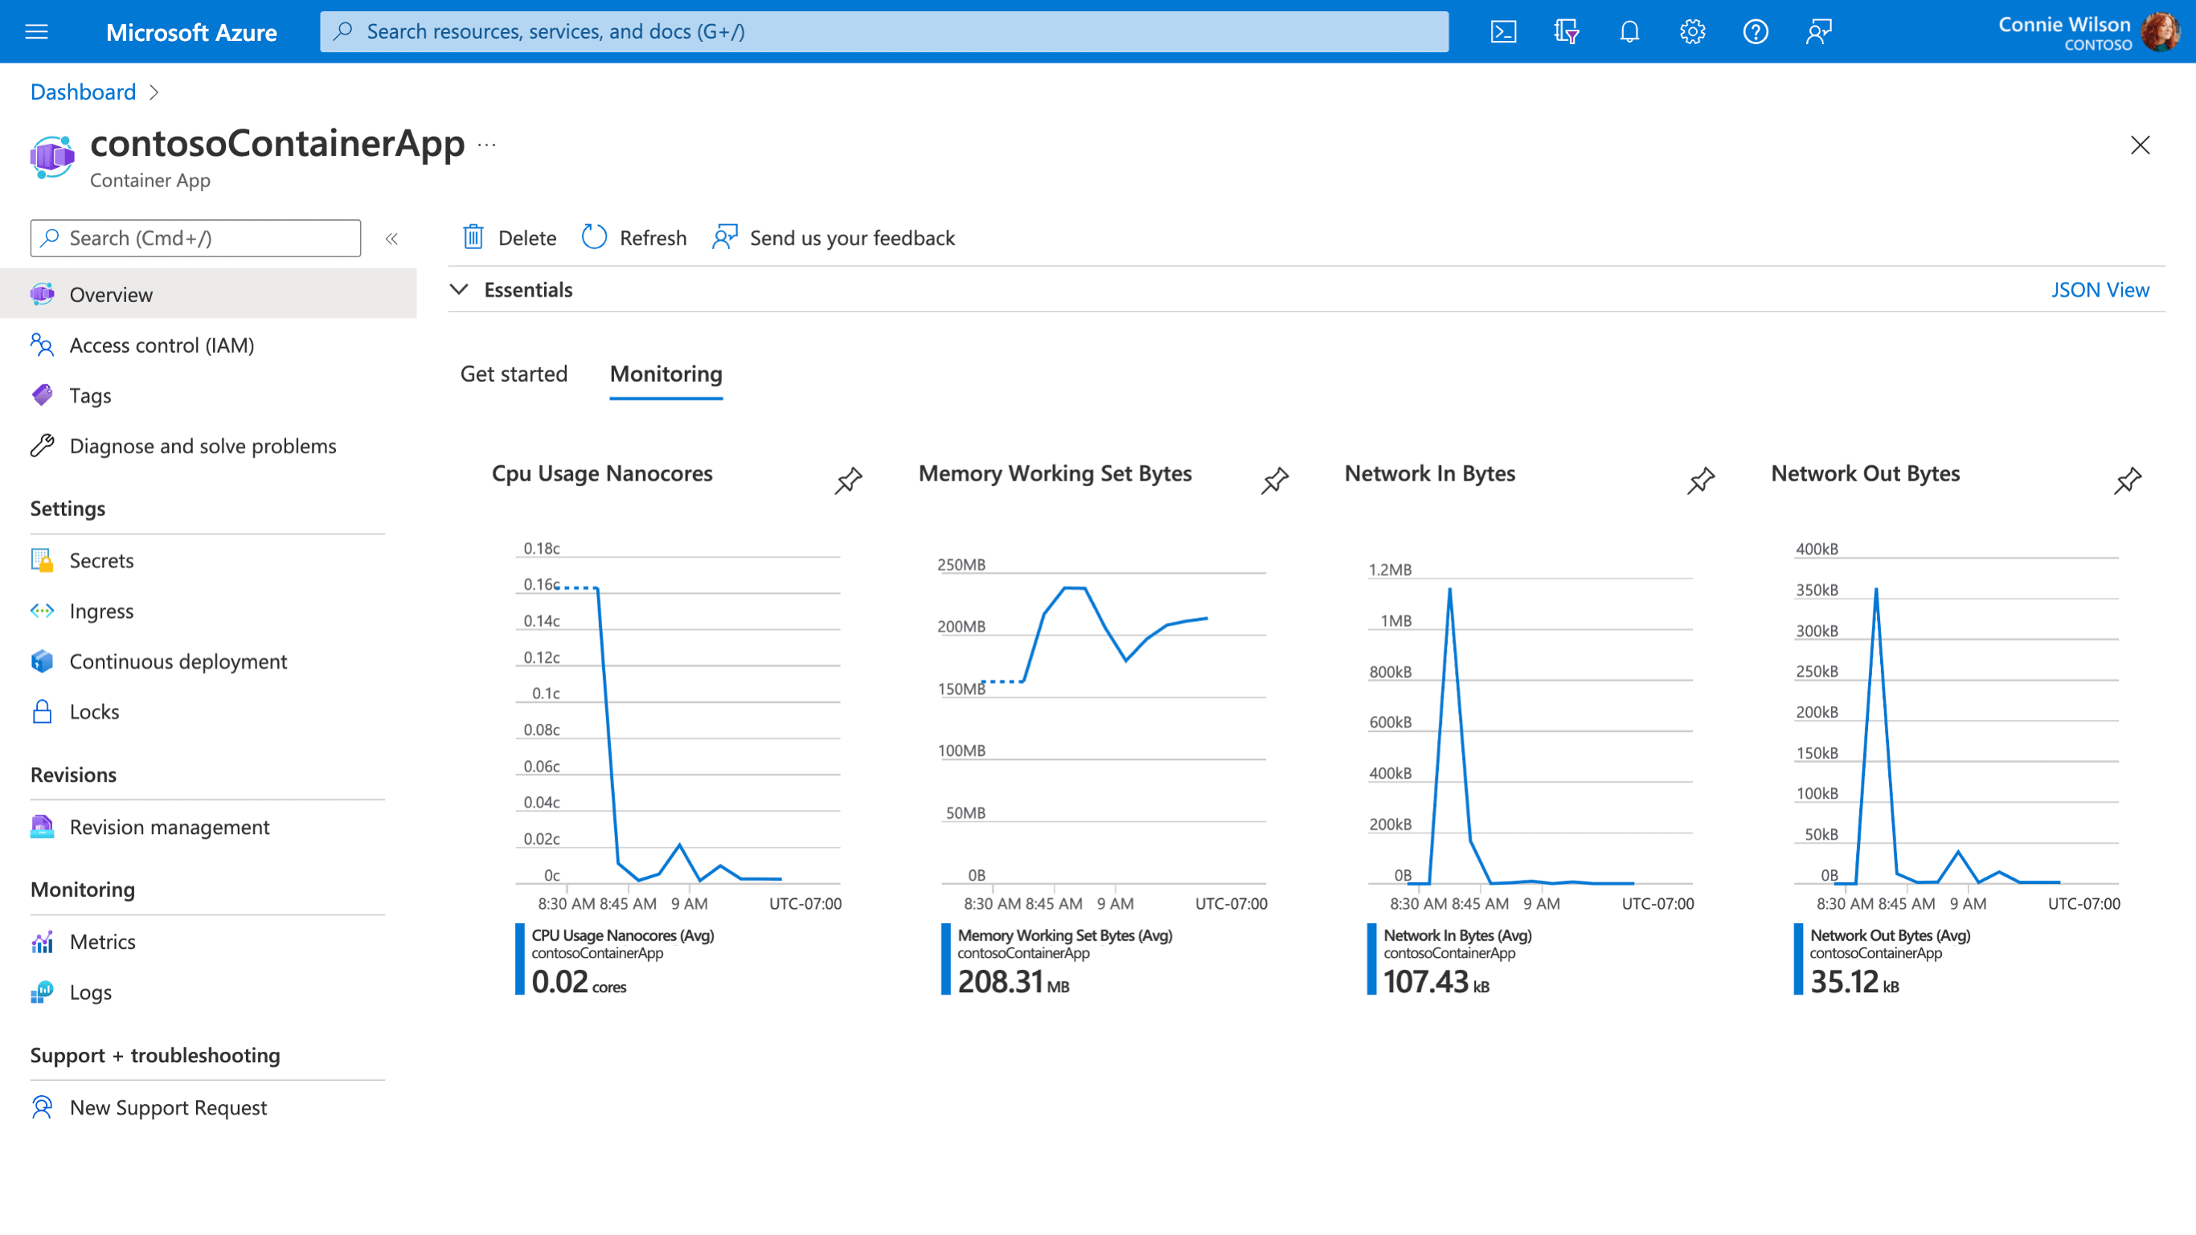
Build modern apps on open source
Focus on apps, not infrastructure
Scale dynamically based on events
Scale dynamically based on events
→
Serverless autoscale based on HTTP requests, KEDA event scale triggers, or CPU and Memory
Declarative scaling rules eliminate the need to manage complex infrastructure
Scale to 0 and pay per use by second
→
→
Notes:
Container Apps is the only serverless container solution offering a combination of robust built-in HTTP-based auto-scaling (including scale to zero), and event-driven auto-scale to run containers that may be processing messages from queues, streams, or databases.
You can run containers and scale in response to HTTP traffic or a growing list of KEDA-supported scale triggers including Azure Event Hub, Apache Kafka, RabbitMQ Queue, MongoDB, MySQL, and PostgreSQL. Scale to zero and pay for only what you use, by the second.

Slide 8
What can you build with Azure Container Apps?
Public API endpoints
Web
Apps
Event-driven processing
Background processing
Microservices
MICROSERVICE A
MICROSERVICE B
HTTP TRAFFIC
MICROSERVICE C
80%
20%
REVISION 1
REVISION 2
Microservices architecture with the option to integrate with Dapr
E.g., API app with HTTP requests split between two revisions of the app
E.g., Web app with custom domain, TLS certificates, and integrated authentication
E.g., Queue reader app that processes messages as they arrive in a queue
E.g., Continuously running background process transforms data in a database
AUTO-SCALE CRITERIA
Individual microservices can
scale independently using any KEDA scale triggers
Scaling is determined by the number of concurrent HTTP requests
Scaling is determined by the number of concurrent HTTP requests
Scaling is determined by the number of messages in the queue
Scaling is determined by the level of CPU or memory load
Notes:
You may be wondering what sort of applications can you build with Azure Container Apps?
Here are some common ones including:
Deploying API endpoints
Hosting background processing applications
Handling event-driven processing
Running microservices
With each of those applications, you can dynamically scale based on:
HTTP traffic
Event-driven processing
CPU or memory load
Any KEDA-supported scaler

Slide 9
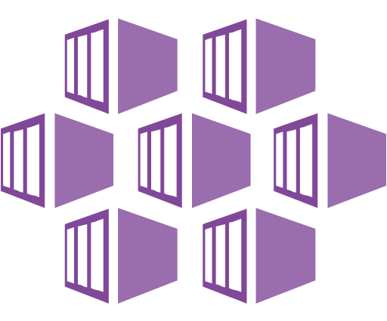
How does ACA compare to AKS?
Azure Kubernetes Service (AKS)
Azure Container Apps (ACA)
Infrastructure focus, higher flexibility
Application focus, infrastructure abstraction
Managed Kubernetes cluster in Azure with full access to the Kubernetes API server and high level of control over cluster configuration with a node-based pricing model
Fully-managed serverless abstraction on top of Kubernetes infrastructure, purpose built for managing and scaling event-driven microservices with a consumption-based pricing model
Core value proposition
Upstream feature parity with a managed control plane
Operations flexibility with advanced customization
Experienced Kubernetes operators
Platform-as-a-Service experience with serverless scale
Developer productivity with low operations overhead
Linux-based, general-purpose stateless containers
Optimized for
Operators deploy node-based AKS clusters using Azure Portal, CLI or Infrastructure-as-Code templates (IaC)
Developers deploy containers via Kubernetes deployment manifests or HELM charts to logically-isolated namespaces within the cluster
Developers deploy containers as individual Container Apps using Azure Portal, CLI or IaC templates without any Kubernetes manifests required
Related container apps are deployed to a shared Container Apps environment comparable to a Kubernetes namespace
Interaction model
Provides a set of cluster extensions and add-ons for operators to enable OSS components in-cluster including Dapr, KEDA, Open Service Mesh, GitOps (Flux), Pod Identity, etc.
Supports manual installation via Kubernetes manifests
Includes opinionated platform capabilities powered by CNCF projects including Dapr, KEDA and Envoy which are fully platform-managed and supported
Envoy: managed ingress and traffic splitting
KEDA: managed, event-driven autoscale
Dapr: codified best practices for microservices
OSS Integration
Notes:
The main focus here is flexibility vs productivity.
This talk is in NO WAY attempting those who use and love AKS today to make them move to Azure Container Apps.
The value prop for ACA is that if you love working with containers, but rather not have to deal with managing the underlying infrastructure, or you don’t want to take the time to learn Kubernetes, Container Apps is a great option.
Cool, so that’s the high level overview of Container Apps. Let’s dive a little deeper.

Slide 10
Enough talk, demo!

Slide 11
Recap
Kubernetes without the Kubernetes!
Use Revisions to manage lifecycle application.
Built in-observability.
Opinionated OSS integration
Support for Dapr Framework
Scaling capabilities with KEDA
Service Discovery with Envoy.

Slide 12






Thanks for listening!
Got questions?
Numerical code: 1019931
willvelida.com
github.com/willvelida
twitter.com/willvelida
linkedin.com/in/willvelida
youtube.com/@willvelida

